Slide 1
Encryption domain content-based image retrieval and convolution through a block-based transformation algorithm
Submitted to:
Dr. A. K. Pal
IIT(ISM), Dhanbad.
Submitted By:
Bikram Kumar
15JE001387

Slide 2
Problem
Today’s world is one of sharing.
Users share images hosted on clouds on the Internet.
In order to provide privacy and ease of access, we need something along the lines of encryption and content based image retrieval.

Slide 3
Solution
A method is proposed for this purpose.
In the proposed method, image retrieval can also be performed directly on the content-protected image

Slide 4
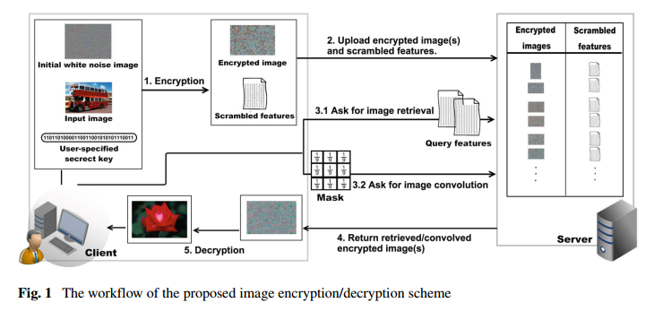
Overview

Slide 5
Algorithm
The algorithm has following broad steps:
Padding (if necessary),
Permutation
Encryption
Decryption
Depermutation

Slide 6
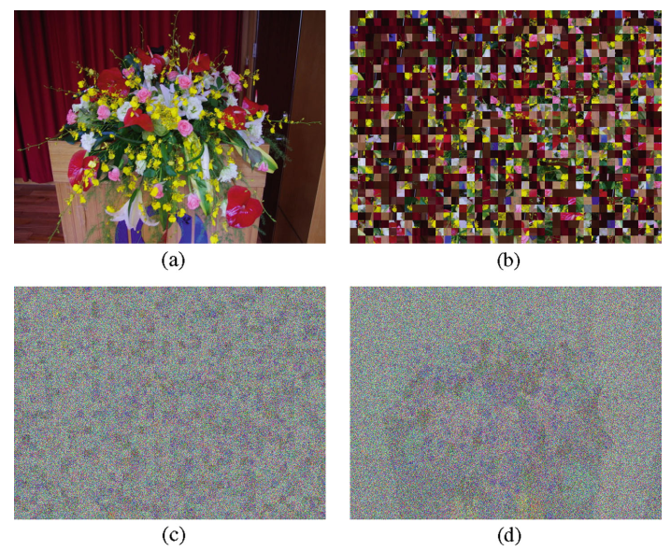
Need for permutation

Slide 7

Test image for the presentation
This image is used for showing the findings of the experiment.

Slide 8
Steps in details

Slide 9
Padding
For block based algorithm, we need to divide image into separate blocks.
If the size of image is not an integral multiple of block size, it cannot be perfectly divided.
Zero padding was applied to the image.

Slide 10

Padding
Original Image (384 x 256)
Padded Image (416 x 288)
For block size 32 x 32

Slide 11
Permuting Image
Permuting is done to scramble the image so that edges and shapes are not visually perceptible.
Permutation is done by creating a permutation vector and scrambling image based on it.

Slide 12

Permuting Image
Padded Image
Permuted Image

Slide 13

Encrypting Image
Image is encrypted using the following equation:
Where:
P_{a} → Plain Image
N₁, N₂ → Noise Image
w₁ … w₆ → Normalizing constants

Slide 14
Creating Noise Images
A noise image of large dimensions is created as a base image.
Separate blocks are randomly chosen and arranged to create a new noise image out of the existing noise image.
This allows for greater number of noise images to be created from a base image.

Slide 15
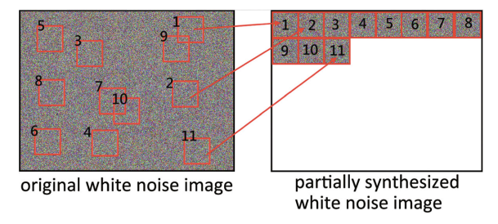
Creating Noise Image

Slide 16

Decrypting Image
The decryption is carried out using the following equation:

Slide 17
Retrieval of image
Encrypted images have similar histograms, so their values are not obvious in the start.
But on calculating difference from their noise image, we are able to differentiate and thus retrieve them based on their content.

Slide 18
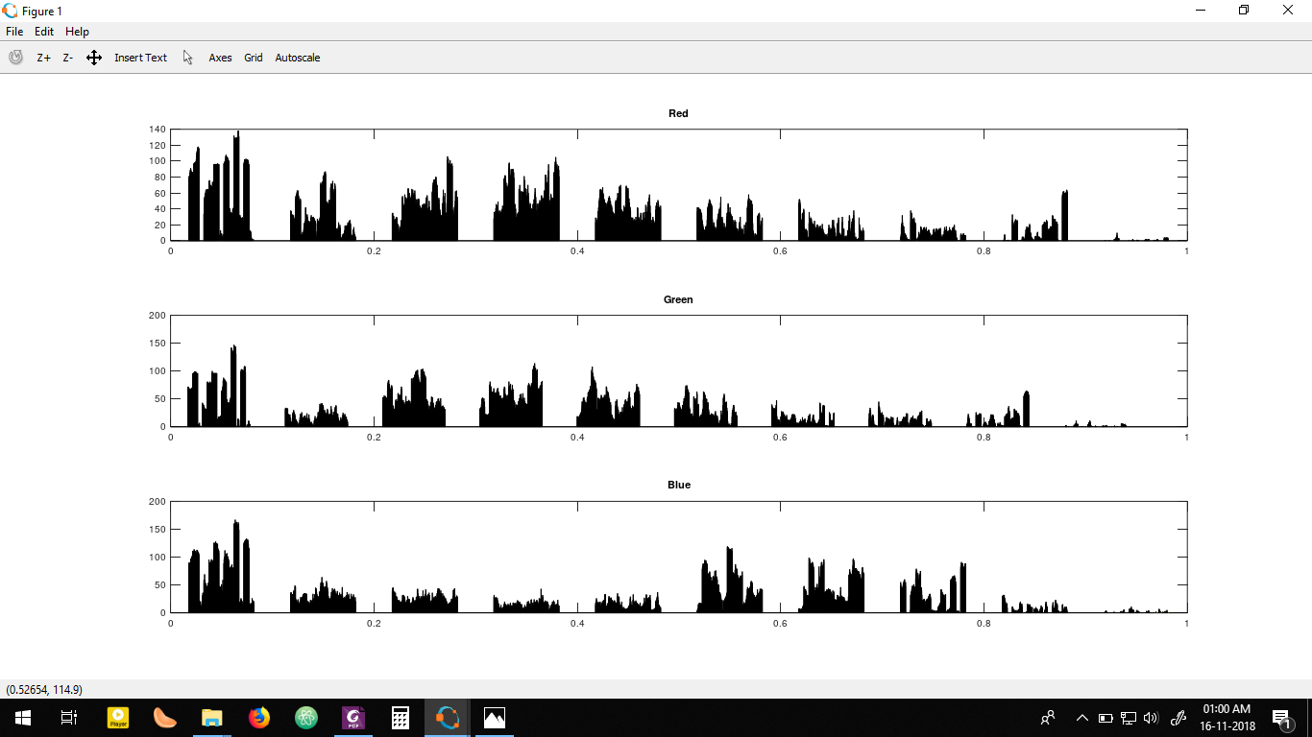
Color Histograms
Original image

Slide 19
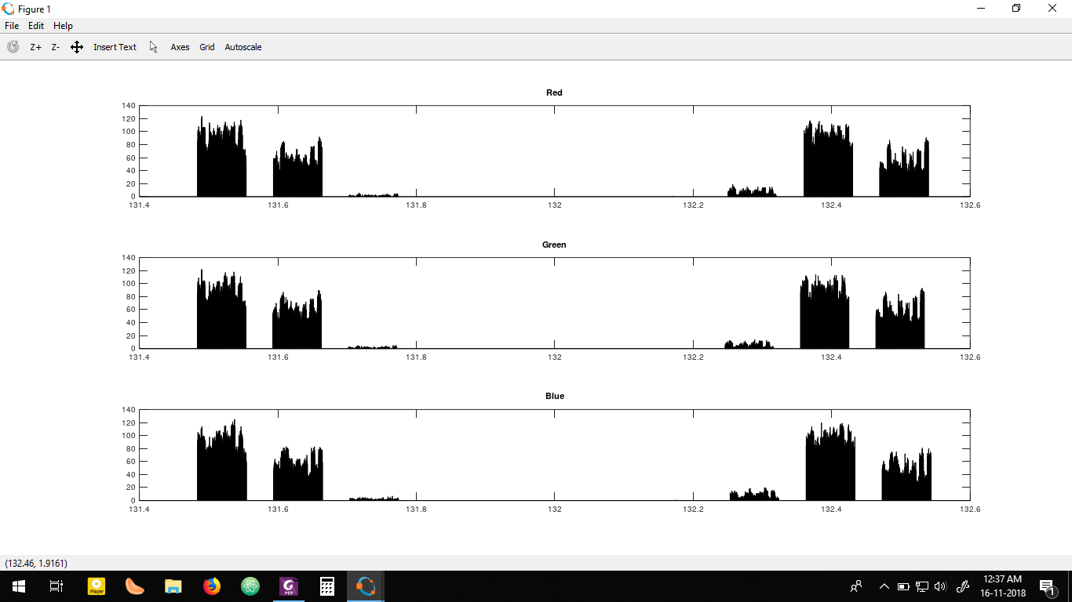
Color Histograms
Encrypted image

Slide 20
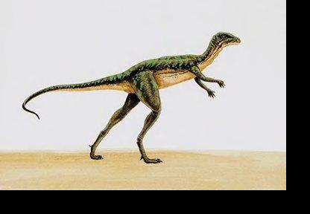
Histograms for different images

Slide 21
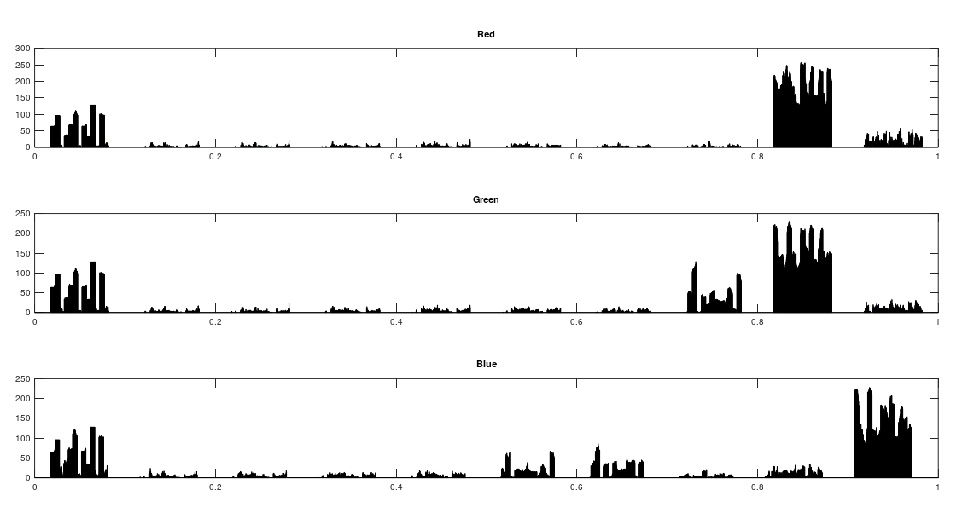
Histograms for different images (plain image)
Sea
Dinosaur

Slide 22
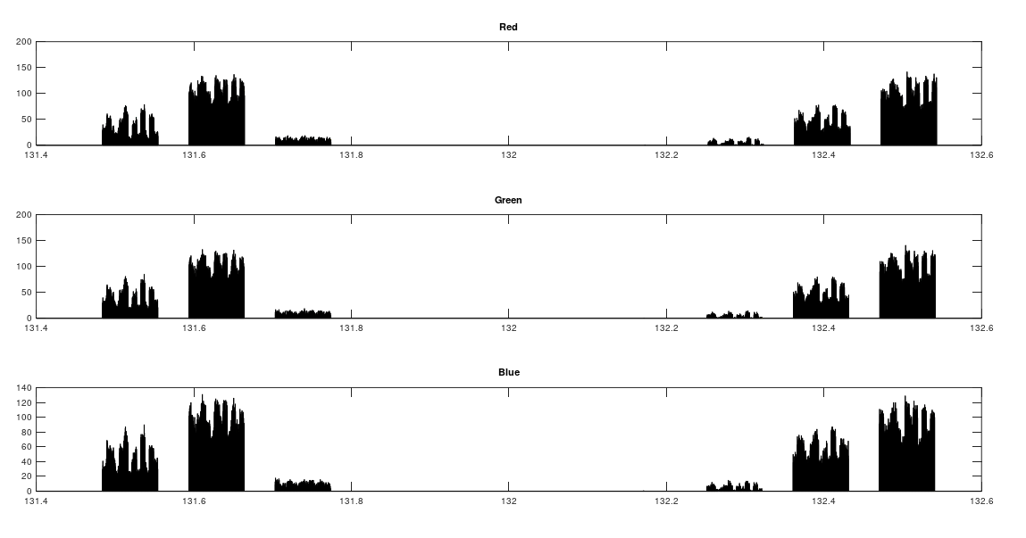
Histograms for different images (encrypted image)
Sea
Dinosaur

